Slide 1



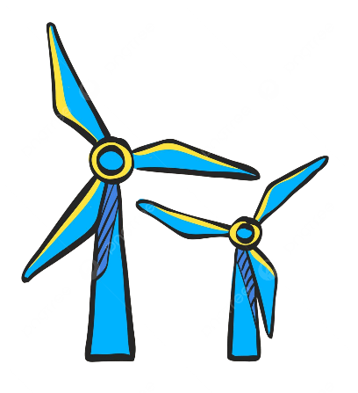
Weekly report: Machine Bed & Yaw System
Week # 2
Date: 30/09/2025
Supervisor: Prof. Quell Peter
Group members: Shoukat Abbas, Luksh Chawla, Sathishkumar Venkatachalam, Shrihari Kadam
Flensburg University of Applied Sciences

Slide 2
Objectives
Components influencing the machine bed
Functions and requirements
Loads relevant to the bedplate
3-point suspension concept
Tower–bedplate interface and dimensions

Slide 3
Machine Bed: Key Influences & Requirements
Components Influencing the Machine Bed
Machine Bed – Requirements
Main rotor bearing
Gearbox
Generator & converter
Nacelle cover
Auxiliary systems
Cables
Service access systems
Lightweight but stiff
Semi design (Main bed casted), reliable for large 5 MW class turbines.
Transport-friendly
Cost-effective and globally manufacturable.
Climate-resistant

Slide 4
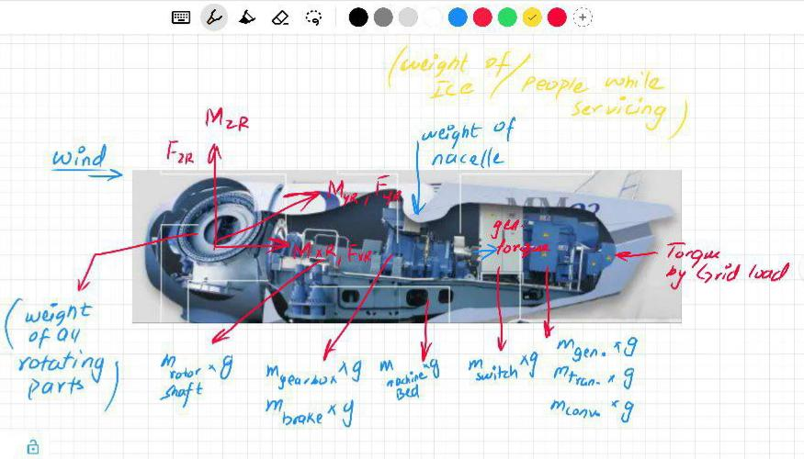
Machine Bed: Loads to Carry, Functions to Fulfil
Functions
Transfers rotor loads (thrust, torque, tilt moments) into tower top.
Provides structural support for rotor bearing, gearbox, generator, converter, hydraulics, transformer, etc.
Loads
Source: REPOWER-MM92 [1]

Slide 5
Estimated load influenced or relevant to Bed plate
1. Rotor Thrust (Fx)
Hub → main shaft → bearings → bedplate, and also into the yaw system.
2. Yaw Bearing Tilt Moment (My)
Yaw bearing due to rotor thrust + side loads, acting as a couple about the tower top.
3. Rotor Torque (Mz)
Rotor → drivetrain → generator, caused by aerodynamic lift on blades.
4. Tower-bottom Moment (Mx/My at tower base)
Rotor loads + nacelle + wind on tower.

Slide 6
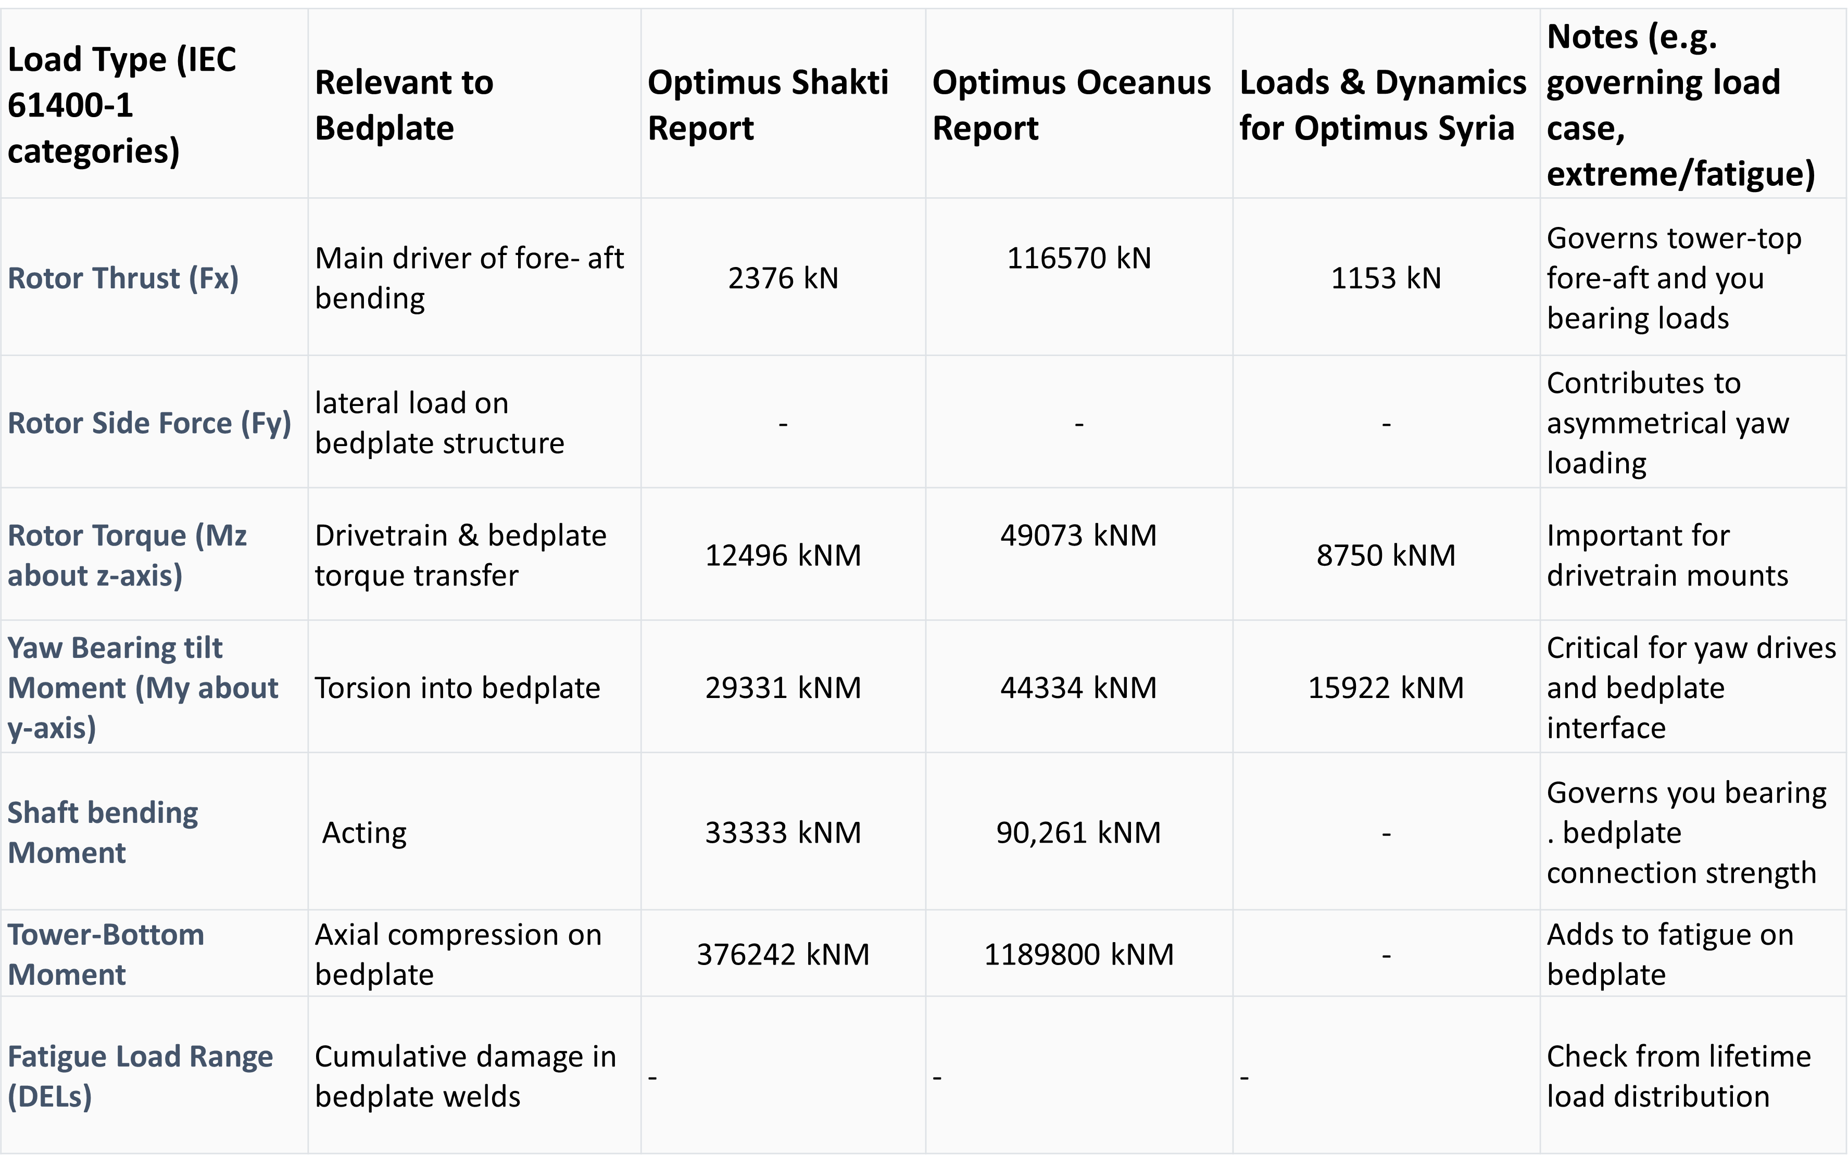
Estimated influenced or relevant to the Bed-plate Load data

Slide 7
3-point suspension affects yaw-drive placement?
Tower Drive Constraints
Blocked drive windows: suspension beams at ~0°, 120°, 240° limit yaw motor locations.
Asymmetric load path if drives cluster → eccentric reactions, higher local stresses.
Lever-arm conflict: beams reduce radial envelope, forcing shorter/offset gearmotors.
Maintenance hurdles: restricted clearance for service, cables, grease lines, and ventilation.
Practical ways to overcome it
Rotate support triangle so beams fall between drive windows.
Multi-level placement: stagger drives above/below yaw ring.
Change tooth orientation: external ↔ internal gear or use idler gears.
Slim/reshaped beams: pockets/scallops near drives with reinforcement.

Slide 8
What “easier” vs “harder” looks like with 3-point
Easier when:
The support triangle is rotated so that the supports fall between the drive windows.
You can use a multi-level or tooth-side flip to clear beams.
Drives remain evenly spaced (low eccentricity), with good access
Harder when:
Supports sit right where drives want to go, forcing clustering.
Beams are deep, and you can’t offset the gearboxes (no standoff space).
No provision for service pockets/pockets not reinforced → compromises stiffness or maintainability.

Slide 9
Tower Interface & Dimensions
Tower Top Diameter
Directly tied to yaw bearing diameter.
Example: 20 MW turbine with 295 m rotor → 7.2 m yaw bearing/tower top diameter.
For a 5 MW turbine with a 122 m rotor → smaller but similarly scaled around 3-3.5 m.
Tower–Bedplate Interface
Flanged connection design.
Yaw bearing mounted on tower flange.
Outer ring fixed to tower top; inner ring mounts nacelle bedplate.
Connection is bolted.

Slide 10
Conclusion
Identified key components and requirements shaping the machine bed.
Reviewed loads from Loads & Dynamics and mapped them to the bedplate.
Analyzed 3-point suspension and its impact on yaw drive placement.
Defined tower–bedplate interface dimensions from benchmarking.

Slide 11
References
[1] the reliable 2-mega watt power plant with 92m rotor diameter uk https://www.scribd.com/document/89867193/REPOWER-MM92-uk

